Slide 1
Lab 7:
Robot Arm I
4/20
Jacky

Slide 2
How to define a robot arm model?
First , define robot kinematics.
Robot kinematics is the kinematics equations of the kinematic chains that form the robot.

Slide 3
In 3D space, we need at most 6 Dof(degree-of-freedom) to describe two different frames, while the fewer variables the better.
We need only 4 variables by using Denavit-Hartenberg Model (DH Model) but we have to follow some rules.

Slide 4
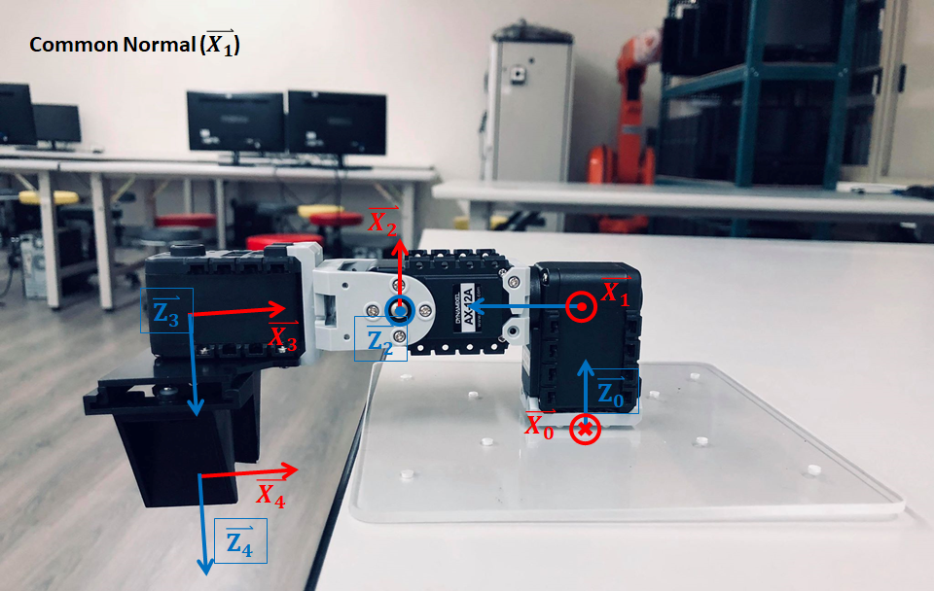
The rules to defines your coordinates are:
the z-axis is in the direction of the joint axis
the x-axis is parallel to the common normal of consecutive two z-axes.

Slide 5
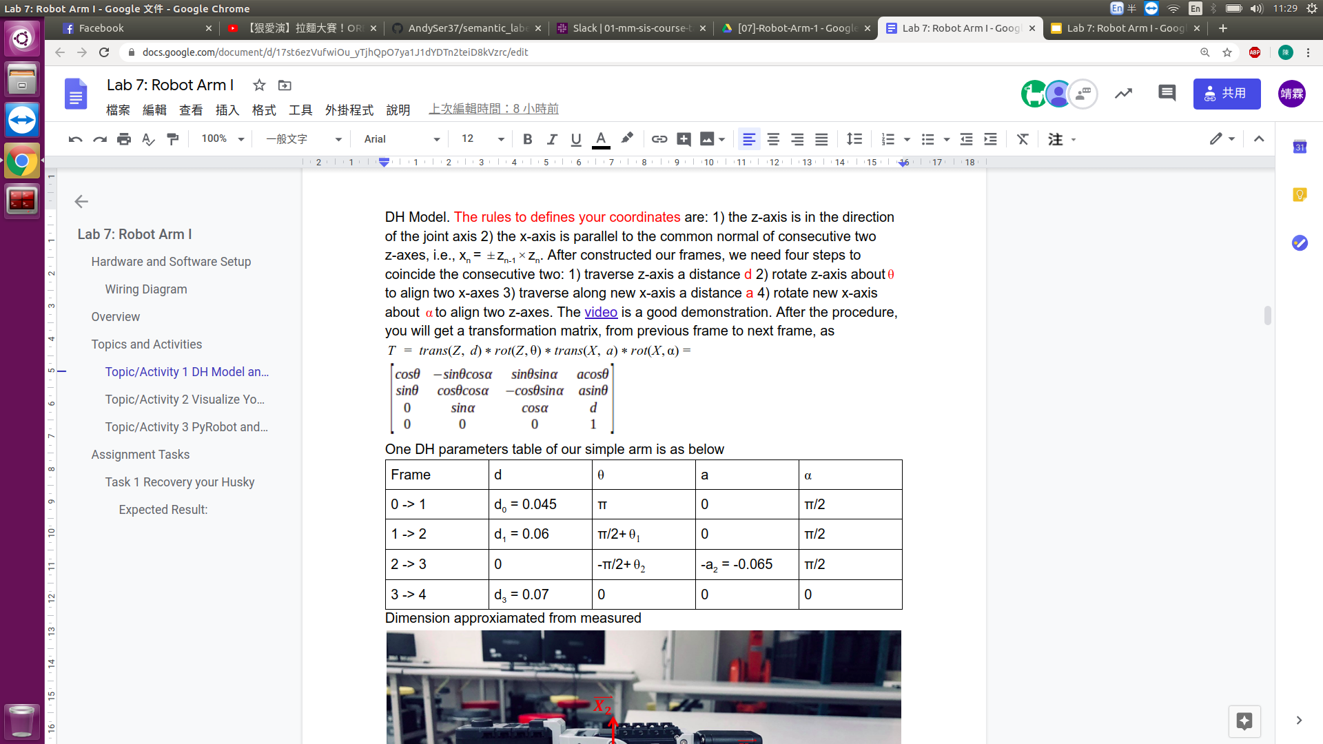
After constructed our frames, we need four steps to coincide the consecutive two:
traverse z-axis a distance d
rotate z-axis about 𝝷 to align two x-axes
traverse along new x-axis a distance a
rotate new x-axis about 𝝰 to align two z-axes.
DH parameters table of our simple arm is as below.
Example

Slide 6
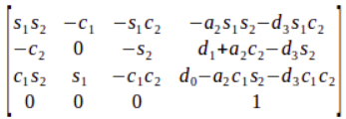
After the procedure, you will get a transformation matrix, from previous frame to next frame, as
After the calculation, the transformation matrix of end effector w.r.t base is

Slide 7
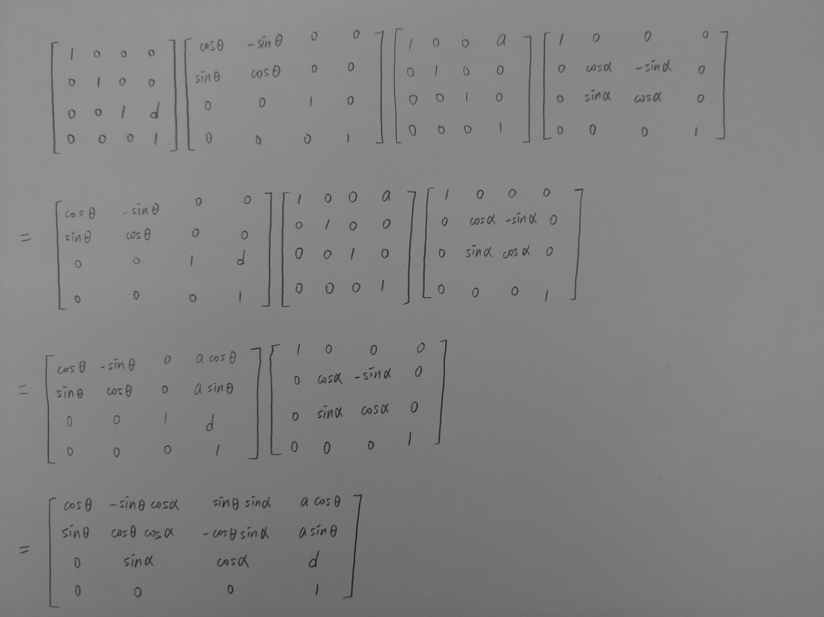

Slide 8
So, given the joints 𝝷1 and 𝝷2, we then know the pose of end effector, such procedure is called as forward kinematic. On the other hand, if we are given the pose of end effector or tool center point and we want to know the sets of joints such that satisfy the pose, the procedure is called as inverse kinematic. FK is easier than IK,while unlucky, in practice case, we meet IK problems more frequently.

Slide 9
Topic/Activity 1 DH Model and Kinematic
Run the launch file to connect Dynamixel servo motor
The request of the server is x, y, z and finger_percentage, which indicates the percentage of gripper closure
Try arbitrary position you want, you may see plan_result as “Success”, “Joint out of range” or “Given point out of range”. If the values you give are in range, you will see the motors start to rotate sequentially

Slide 10
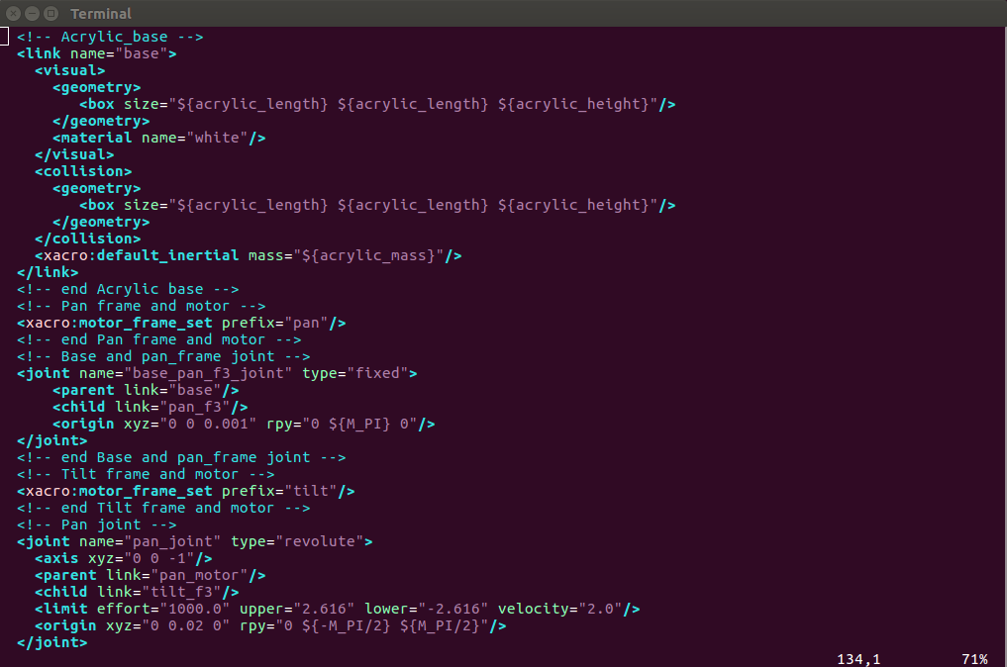
Topic/Activity 2 Visualize Your Robot With URDF
So now we have a simple robot arm, can we visualize it in RViz? Sure we can, but we need the help of URDF, unified robot description format, to describe our robot. URDF is an XML-format file like launch for representing your robot model.

Slide 11
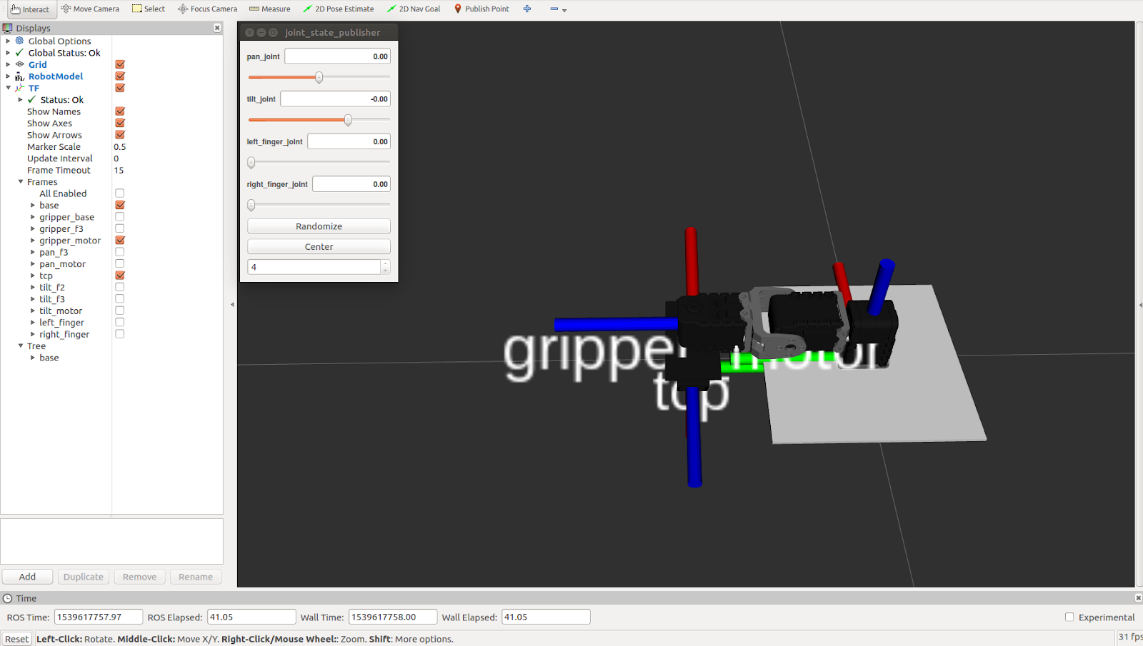
Run launch file to show the robot arm model in Rviz
Besides RViz window, there is an additional window named joint_state_publisher, with four bars inside. Slide the bars and see what magic happen

Slide 12
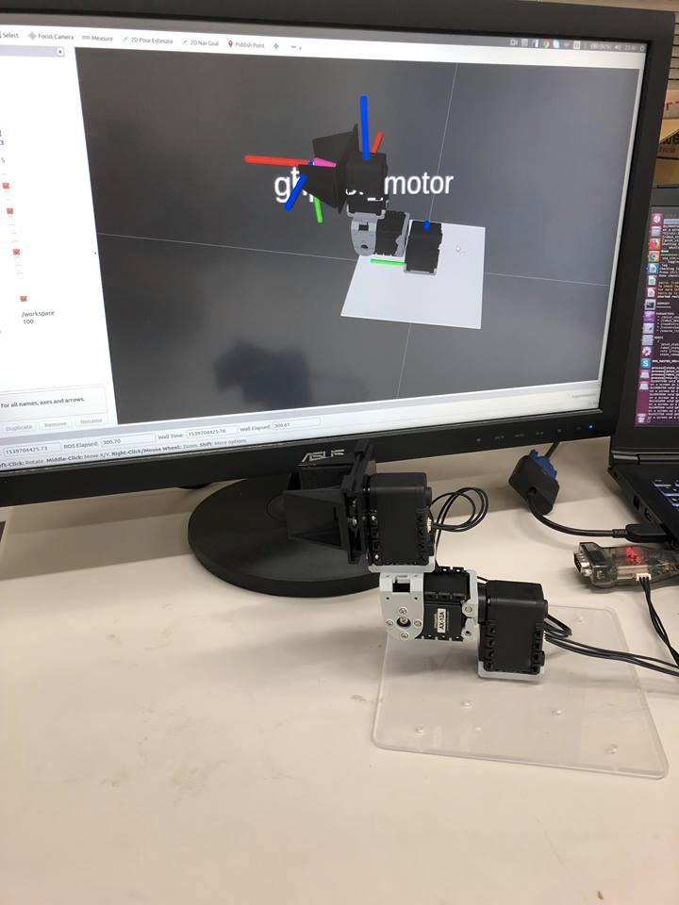
We can simulate our simple arm in RViz, but what we want is to link from real-world robot to RViz, let’s change use_sim parameter from true to false
Now, the joint_state_publisher window is disappeared and the pose of our model is the same as the real one

Slide 13
Topic/Activity 3 PyRobot and LoCoBot
This topic introduces what is PyRobot and LoCoBot.
PyRobot is a Python package for benchmarking and running experiments in robot learning. The goal of this project is to abstract away the low-level controls for individual robots from the high-level motion generation and learning in an easy-to-use way.
LoCoBot, a low cost mobile manipulator robot.

Slide 14
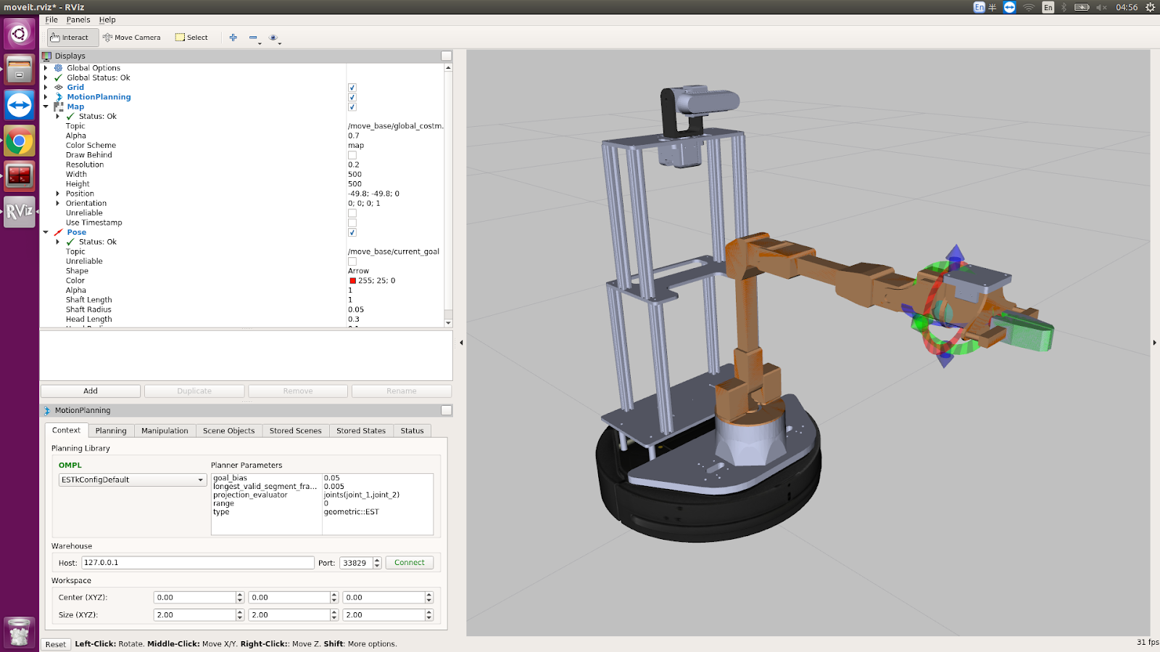
First , enter docker container to run the launch file
Now you can see LoCoBot in Rviz
Next , run the script to control LoCoBot’s arm

